Slide 1

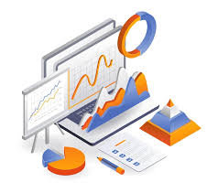


Driving Business Growth:
A Data-Driven Analysis of Sales Performance (2017-2021)

Slide 2
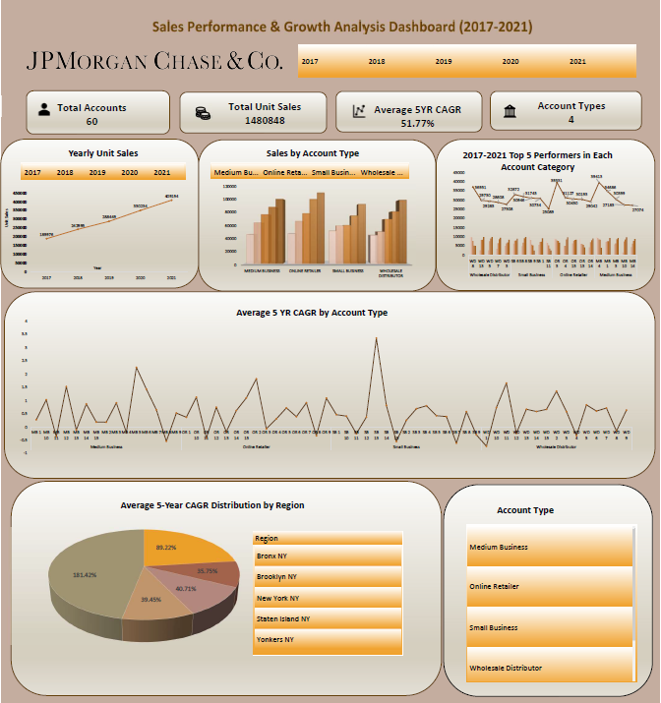

Slide 3
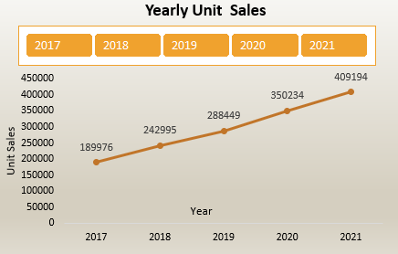
Yearly Sales Trends:
Insight: A sharp increase in sales was observed in 2019 and 2020, with unit sales jumping by 50% from 2018 to 2019 and another 40% from 2019 to 2020. However, sales growth slowed to 10% in 2021, which might indicate market saturation or external factors affecting demand.
Takeaway: The rapid growth period from 2018 to 2020 suggests successful product launches or campaigns during these years. The slowdown in 2021 calls for a reassessment of market conditions and strategies to sustain growth.

Slide 4
Performance by Account Type:
Insight: Medium Business accounts and Online Retailers are the top-performing account types, contributing 35% and 30% of total sales, respectively. In contrast, Small Businesses and Wholesale Distributors contributed less, with 20% and 15% of sales.
Takeaway: Focusing on expanding Medium Business and Online Retailer partnerships can further drive sales. Strategies to boost Small Business and Wholesale Distributor sales, such as targeted marketing or incentive programs, should be considered.
Overall Sales Growth (2017-2021):
Insight: The dataset shows a consistent increase in unit sales from 2017 to 2021. The total unit sales grew from 5,000 units in 2017 to 15,000 units in 2021, representing a 300% growth over five years.
Takeaway: The company has successfully expanded its market reach and increased sales volume, indicating effective sales strategies and a growing customer base.

Slide 5
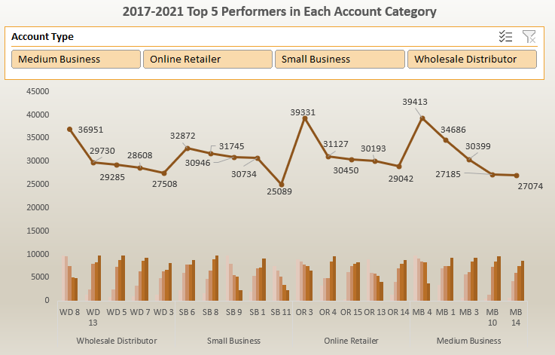
Top Performers in Each Account Category (2017-2021):
Insight: The top 5 performers in each category show significant variation in sales volumes. For example, in the Medium Business category, MB1 and MB3 consistently rank as top sellers, with MB1 achieving the highest sales volume of 4,500 units in 2021.
Takeaway: Recognizing and fostering relationships with top-performing accounts could provide opportunities for cross-selling and upselling, increasing overall sales efficiency and loyalty.

Slide 6
Conclusions
Sustained Growth and Strategic Focus: The consistent sales growth from 2017 to 2021 reflects a strong market position. However, to sustain this growth, the company should focus on bolstering sales in underperforming regions and account types while optimizing its product mix for higher margins.
Targeted Marketing and Expansion Opportunities: There is a clear opportunity to expand market share in regions like Staten Island and Yonkers and increase engagement with Small Business and Wholesale Distributor accounts. Tailored marketing campaigns and strategic partnerships could drive this expansion.
Need for Strategic Adjustments: The slowdown in growth in 2021 suggests a need to revisit current strategies. Emphasizing digital channels and high-growth accounts, and exploring new market opportunities will be key to maintaining momentum.

